Slide 1

Cyclic Locking and Memristor-based Obfuscation Against
CycSAT and Inside Foundry Attacks
Paper Review – Nahush D. Tambe
ECGR 8090 – Hardware Security & Trust

Slide 2
Defining Key Terms...
CycSAT-I Attack – 1st version of SAT-based attack on cyclic logic locking, like attack on acyclic circuits if there exists a correct key under which the circuit is acyclic.
  Cyclic locking with dummy cycles insertion of acylic circuits has been successfully attacked by CycSAT-I
  To defeat CycSAT-I, correct circuit should have at least 1 real cycle.
CycSAT-II Attack – 2nd version where the assumption that the original circuit should by cyclic is relaxed.
  To defeat CycSAT-II, correct circuit should have at least 1 hard/ non-bipartitionable cycle (Hard cycle can be defined as a cycle that would be missed in the cyclic condition generation of the CycSAT attacks).
  Traversal in any topological order will miss the hard cycle and SAT engine will not find the correct key or get stuck in a infinite loop.
Memristor – Electrical component that regulates or limits the flow of electrical current in a circuit and remembers the amount of charge previously flowed through it.
Polymorphic memristor-CMOS Gate – Multi-functional gates , in which change of their behavior is a result of modifications in the characteristics of their components. (e.g. changing memristor’s resistance by changing the direction of the current) after fabrication.
  With polymorphic memristor-CMOS obfuscation, the layouts of the circuits with different functionalities may look identical, making it impossible even for an inside foundry attacker to distinguish the defined functionality of an IC by looking at its layout.

Slide 3
Paper Summary – A Brief Introduction
A significant challenge for the semiconductor industry is to protect IC designs from Reverse Engineering (RE) and Inside Foundry Attacks (IFA).
To address the same, a 2-step approach is suggested. First, locking IC designs to ensure correct behavior only with the application of the correct key. Second, implementing obfuscation is recommended to prevent the revelation of the correct circuit through structural analysis.
Hardware protection for ICs distinguishes itself from software protection due to the unique challenges posed by the potential knowledge of IC functionality by other parties. Previous efforts have primarily focused on acyclic combinational circuits. Logic encryption, involving the insertion of key-controlled gates and subsequent logic resynthesis for obfuscation.
Thus, the challenge in hardware protection involves two main aspects:
  Proposing locking schemes to counter key-pruning attacks
  Finding circuit obfuscation solutions to prevent IFA

Slide 4
Paper Summary
Common impression that combinational circuits must be designed without any cycles. However, circuits with cycles can be combinational as well.
So, why circuits with cycles? It is proposed that cyclic combinational circuits can make logic locking stronger.
Paper proposes 2 step process:
  Defeating the state-of-the art key pruning attacks by first converting the acyclic circuit to a cyclic one and then introducing hard cycles.
  Next, overcoming the problem of IFA by employing polymorphic memristor-CMOS gates instead of using traditional dummy contact and doping-based solutions.

Slide 5
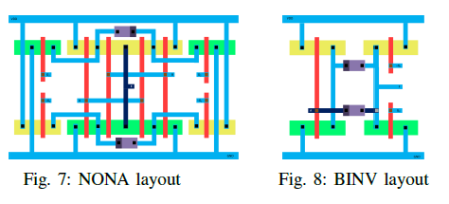
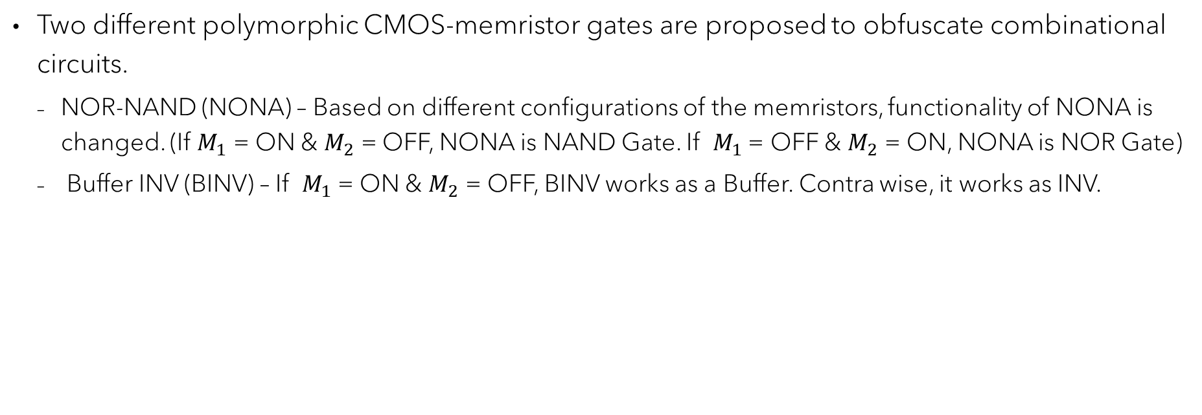
Paper Summary Continued ...
Two different polymorphic CMOS-memristor gates are proposed to obfuscate combinational circuits.
  NOR-NAND (NONA) – Based on different configurations of the memristors, functionality of NONA is changed. (If $M_{1}$ = ON & $M_{2}$ = OFF, NONA is NAND Gate. If $M_{1}$ = OFF & $M_{2}$ = ON, NONA is NOR Gate)
  Buffer INV (BINV) – If $M_{1}$ = ON & $M_{2}$ = OFF, BINV works as a Buffer. Contra wise, it works as INV.
Fig. 7 and 8 show layouts of the polymorphic memristor-CMOS gates (NONA and BINV.) The layout of different gates (i.e. NOR/NAND in NONA and BUFFER/INV in BINV) look identical to anyone that has access to the layout, including third party engineers who manufacture the chip.

Slide 6
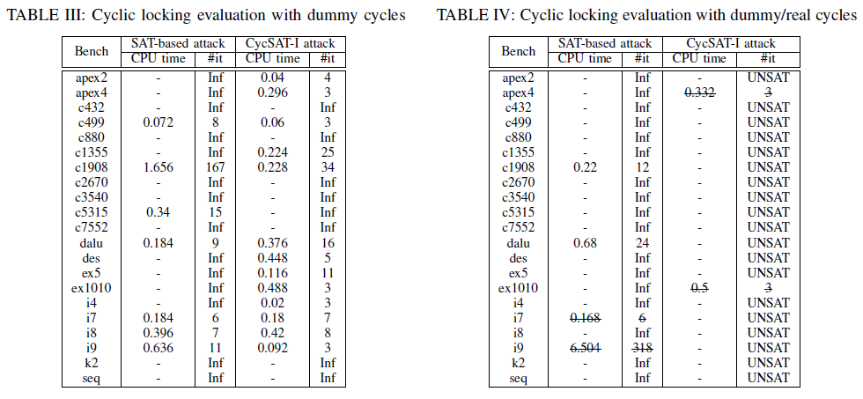
Experimental Results – Cyclic Locking Evaluation
From Table III, benchmarks with only dummy cycles, CycSAT-I generally performs better than the original SAT-based attack. In cases with Inf iterations, the SAT solver gets stuck in an infinite loop and cannot report any key.
In Table IV, both attacking schemes have bad unlocking performance when real and dummy cycles co-exist in the benchmarks.
The SAT-based attack gets trapped in an infinite loop when solving most of the locked circuits and sometimes even returns wrong keys (i.e. i7 and i9.)
On the contrary, CycSAT-I in most of the cases returns no key because the correct key has already been pruned by the acyclic condition.
As anticipated, when real and dummy cycles are added into the benchmarks, CycSAT-I attack has 0% success rate.
Results for CycSAT-II are not available and experimented with.

Slide 7
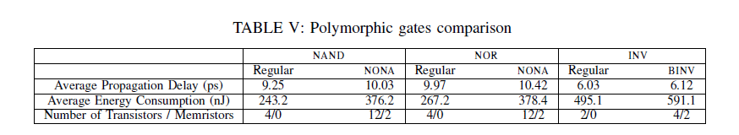
Experimental Results – Polymorphic Gates Evaluation
Table V shows the overhead of NONA and BINV compared with the regular gates in 45nm CMOS technology.
On average, propagation delay of NONA and BINV are 7% and 6% more than regular gates respectively. Also, energy consumption of NONA and BINV are on average 40% and 20% more than regular gates respectively.
As an example, if an obfuscation scheme exchanges 5%, 10%, and 20% of the regular gates with polymorphic ones using an equal distribution of NONA and BINV, the total area overhead is less than 8%, 15%, and 30% respectively that seems reasonable for an obfuscation approach.

Slide 8
Key Strengths
Tackling Reverse Engineering (RE) and Inside Foundry Attacks (IFA) is a formidable challenge in the realm of Hardware security. The use of cyclic locking and polymorphic-CMOS memristor-based idea is a novel attempt and the results from the previous slide underscore the efficacy of this innovative strategy, especially in mitigating SAT based attacks.
For cyclic locking, the results establish that in general, the SAT based attack and CycSAT-I fail to obtain the correct key combination and either produce a wrong key or get stuck in an infinite loop altogether, for most of the benchmarks. Table III and IV prove the same.

Slide 9
Major Weaknesses
The paper briefly discusses CycSAT-II Attack, and techniques that can be implemented to detect and mitigate the attack. But the experimental testing's does not include the test results for the CycSAT-II attack, and thus, it cannot be established how well the Memristor-based Obfuscation techniques are useful in mitigating CycSAT-II attacks.
From Table V, the energy consumption of NONA and BINV are on average 40% and 20% more than the regular gates. 20% seems reasonable for the BINV, but 40% is a number that is significantly higher for the NONA gates.

Slide 10
Related Works Analyzed ...
“Memristor – The missing circuit element” by L. Chua in IEEE Transactions on Circuit Theory
  The paper introduces a new, fourth basic circuit element called the memristor that can be characterized by a relationship between the charge along with an electromagnetic field interpretation of this relationship in terms of a quasi-static expansion of Maxwell's equations. It is shown that this element exhibits some peculiar behavior different from that exhibited by resistors, inductors, or capacitors. These properties lead to a number of unique applications which cannot be realized with RLC networks alone.
“Design methods for polymorphic digital circuits” by L. Sekanin in Design and Diagnostics of Electronic Circuits and Systems Workshop (DDECS)
  The recent introduction of Polymorphic Electronic Gates has sparked a keen interest in leveraging their unique characteristics to propel advancements in digital circuitry. The unique ability to dynamically alter their functionality in response to variations in power supply voltage, temperature, and other environmental factors enhances their applicability across diverse domains, with a particular focus on logic locking. The paper not only introduces the concept of polymorphic gates but also delves into a comprehensive analysis and discussion of various methodologies for designing electronic circuits at the gate level that harness the potential of polymorphism.

Slide 11
Comparison with Reference # 15
Title: Cyclic Obfuscation for Creating SAT-Unresolvable Circuits (by K. Shamsi, M. Li, T. Meade, Z. Zhao, D. Z. Pan, and Y. Jin)
Published in 2017 in International Conference on Great Lakes Symposium on VLSI (GLSVLSI)
Proposes a novel approach towards mitigating SAT attacks by creating interconnection cyclic obscurity that can be applied to both logic locking and IC Camouflaging.
The key idea is that if a logical loop is created in the circuit (which is typically avoided in prior work [16]), through adding dummy wires and gates, the adversary cannot launch the existing SAT attacks, since the circuit can no longer be represented as a directed acyclic graph (DAG).
States that current SAT attacks are incapable of reverse engineering cyclic circuits, but I
On the Other hand, my paper states that the Cyclic locking with dummy cycles insertion of acylic circuits has been successfully attacked by CycSAT-I and thus proposes methods to further mitigate the advancements in SAT attack algorithm.

Slide 12
Comparison with Reference # 16
Title: CycSAT: SAT-Based Attack on Cyclic Logic Encryptions (by H. Zhou, R. Jiang, and S. Kong)
Published in 2017 in International Conference on Computer-Aided Design (ICCAD)
States that with the introduction of a new technique, Cyclic Logic Encryption in the field of Hardware security, it was claimed to be SAT-unresolvable because of its intentional use of feedback cycles insertion.
This paper shows that even though feedback cycles introduce extra difficulty for an attacker, they can still be overcome with SATbased techniques. Specifically, CycSAT Algorithms based on SAT have been proposed.
Experimental results have shown that our CycSAT is efficient and effective to decrypt cyclic encryptions.
My paper agrees with this paper as CycSAT-I and CycSAT-II have been proven to be efficient in breaking down cyclic circuits.

Slide 13
References...
A. Rezaei, Y. Shen, S. Kong, J. Gu and H. Zhou, "Cyclic locking and memristor-based obfuscation against CycSAT and inside foundry attacks," 2018 Design, Automation & Test in Europe Conference & Exhibition (DATE), Dresden, Germany, 2018, pp. 85-90, doi: 10.23919/DATE.2018.8341984.
K. Shamsi, M. Li, T. Meade, Z. Zhao, D. Z. Pan, and Y. Jin, “Cyclic obfuscation for creating SAT-unresolvable circuits,” In International Conference on Great Lakes Symposium on VLSI (GLSVLSI), pp. 173-178, 2017.
H. Zhou, R. Jiang, and S. Kong, “CycSAT: SAT-based attack on cyclic logic encryptions,” In International Conference on Computer-Aided Design (ICCAD), 2017.

Slide 14
Questions ??
Thank You !!

